Slide 1
Piecewise Defined Relationships & Step Graphs

Slide 2
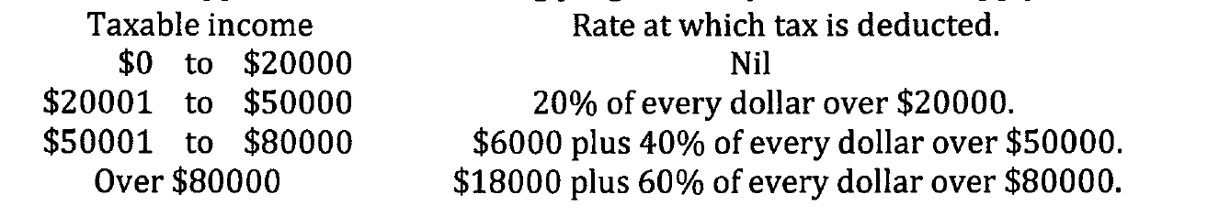

Slide 3
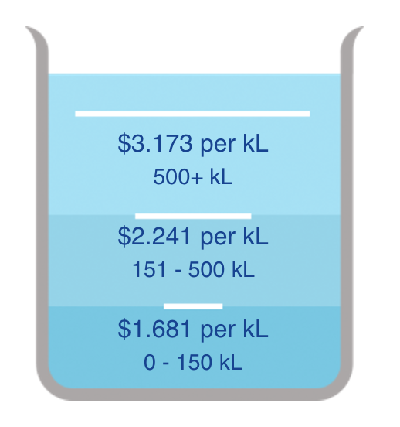
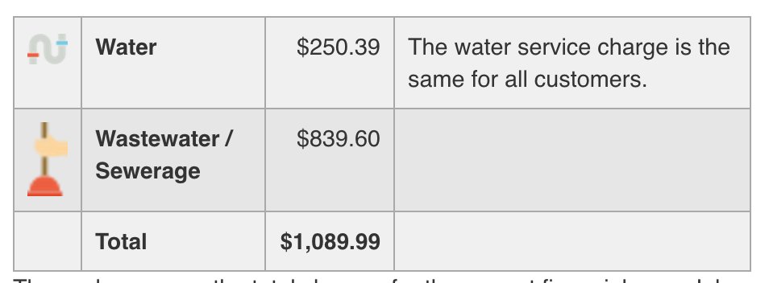
Water charges
Notes:
https://www.watercorporation.com.au/my-account/your-bill-and-charges

Slide 5
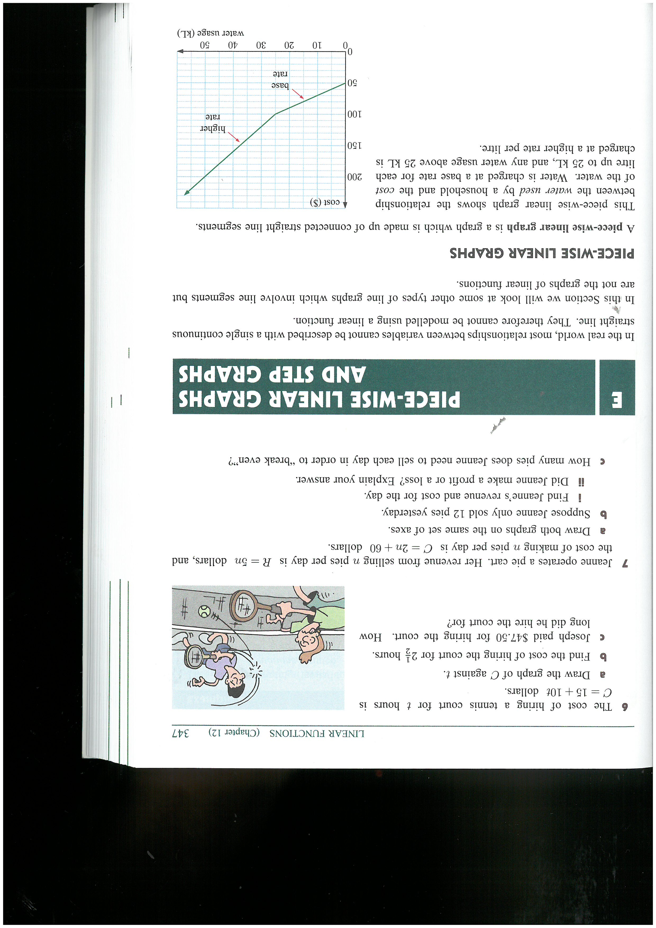
Piecewise Linear Graph
Piecewise defined relationship
Relationship which cannot be defined with a single continuous linear relationship
Different rules applied for different pieces of the horizontal axis.

Slide 6
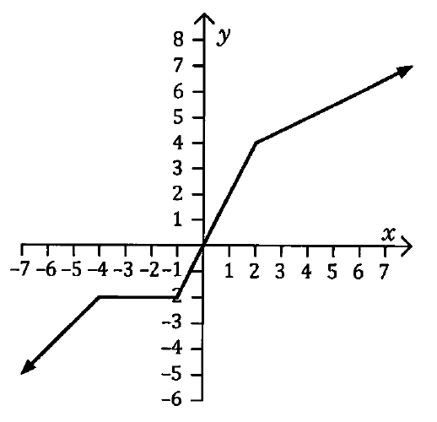
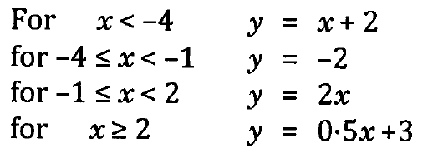

Slide 7
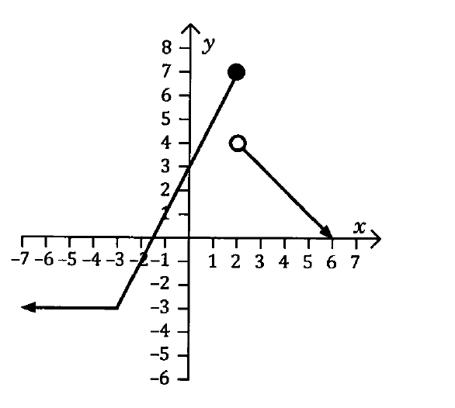
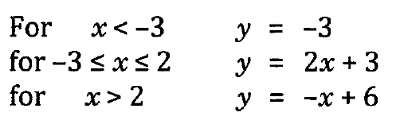

Slide 8
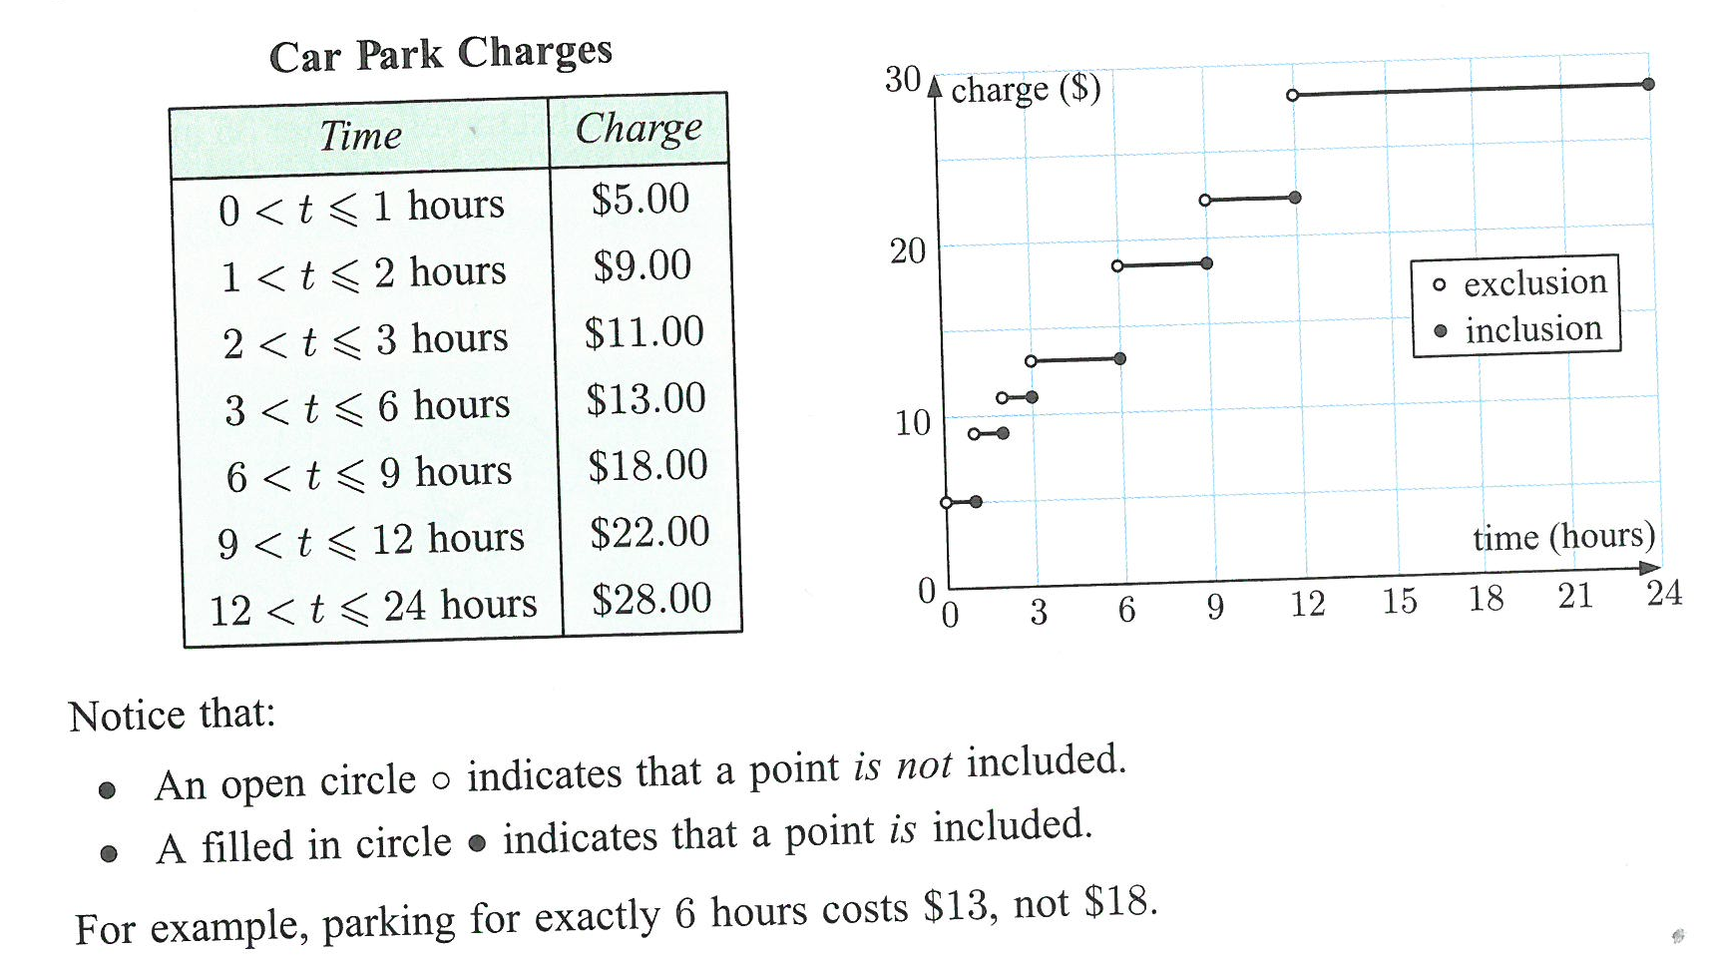
Step Graph
Consists of a series of horizontal lines.
Example – cost of parking in a car park

